Slide 1

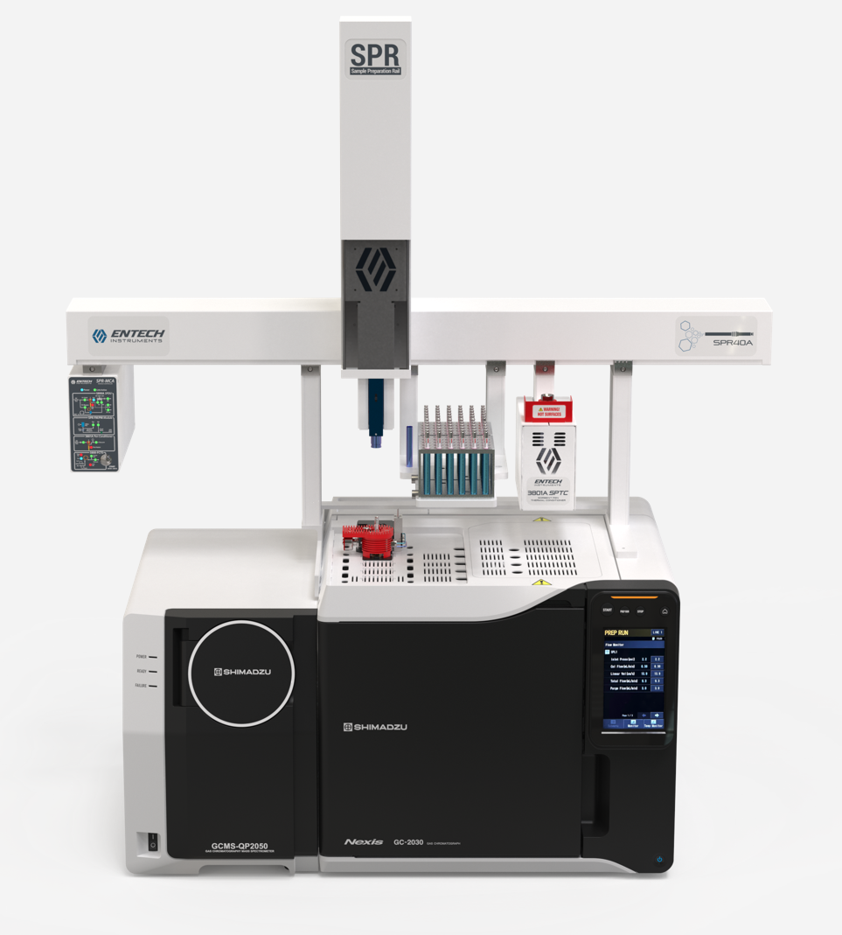

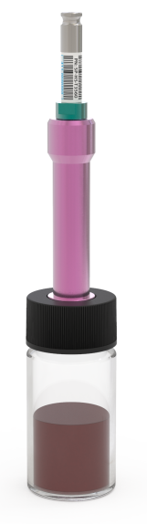
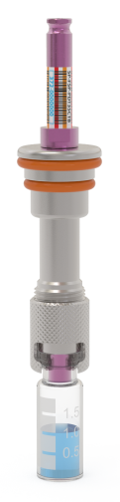
What we have Learned from 36 Years of Research on GREEN GCMS Sample Preparation
Daniel B. Cardin
CEO/Product Development
Weier Hao
Senior Applications Scientist
Vicki Vogel
Senior Applications Scientist
Daniel J. Cardin
Silonite Coating and QA Manager
R&D/Product Development Teams
Sorbent Pen Analysis Analysis
VASE FEVE

Slide 2
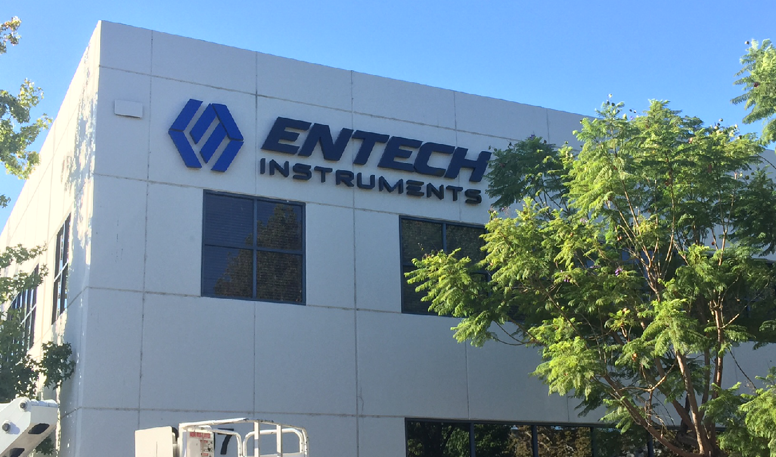
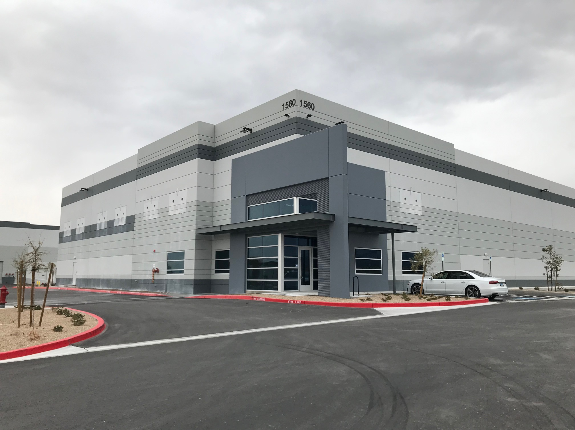
Introducing Entech Instruments
Celebrating 36 Years of Analytical Instrument Manufacturing (1990-2026)
68 Employees
Entech Europe, GmbH near Frankfort
Facilities:
  Simi Valley CA, 37,000 sq ft for air monitoring solutions
  Las Vegas NV, 36,000 facility in Las Vegas Developing Sorbent Pen Systems for GCMS Sample Prep
    Air, Water, Soil, Foods, Plastics
    VOCs, SVOC, PFAS

Slide 3
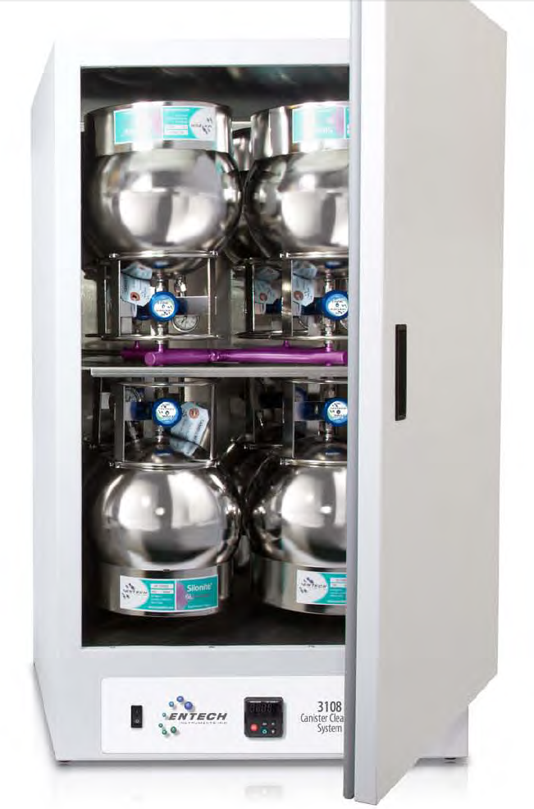
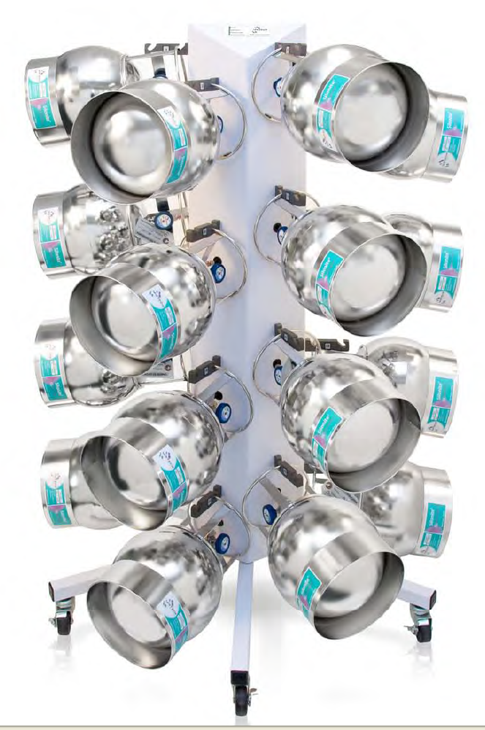
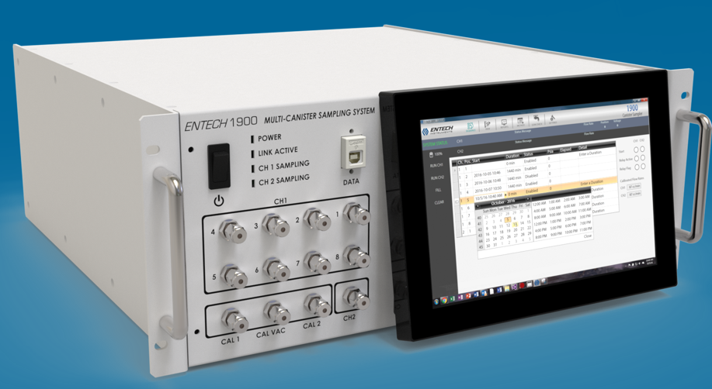
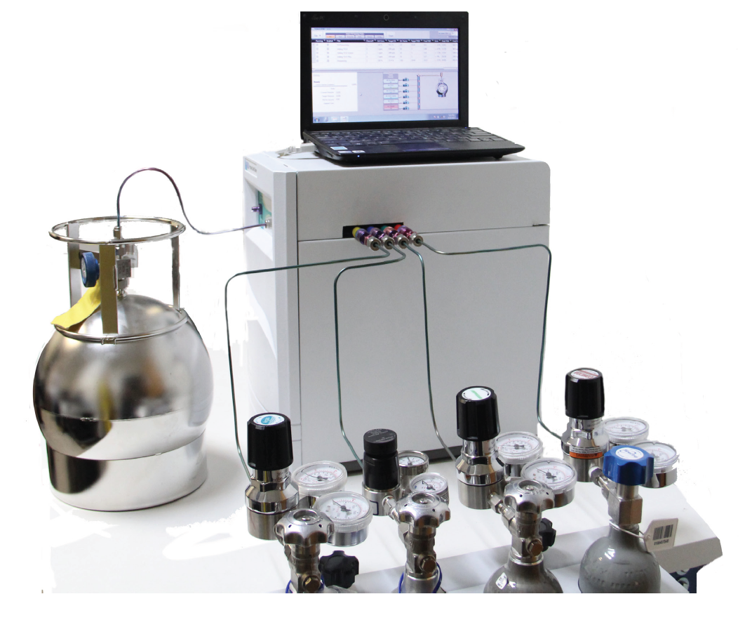
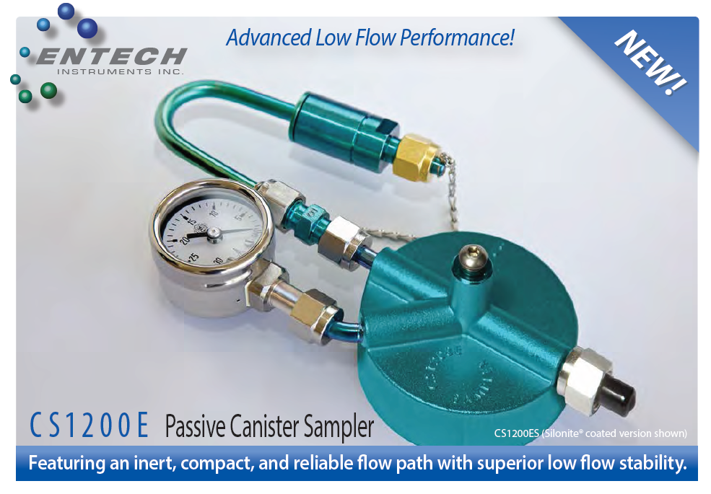

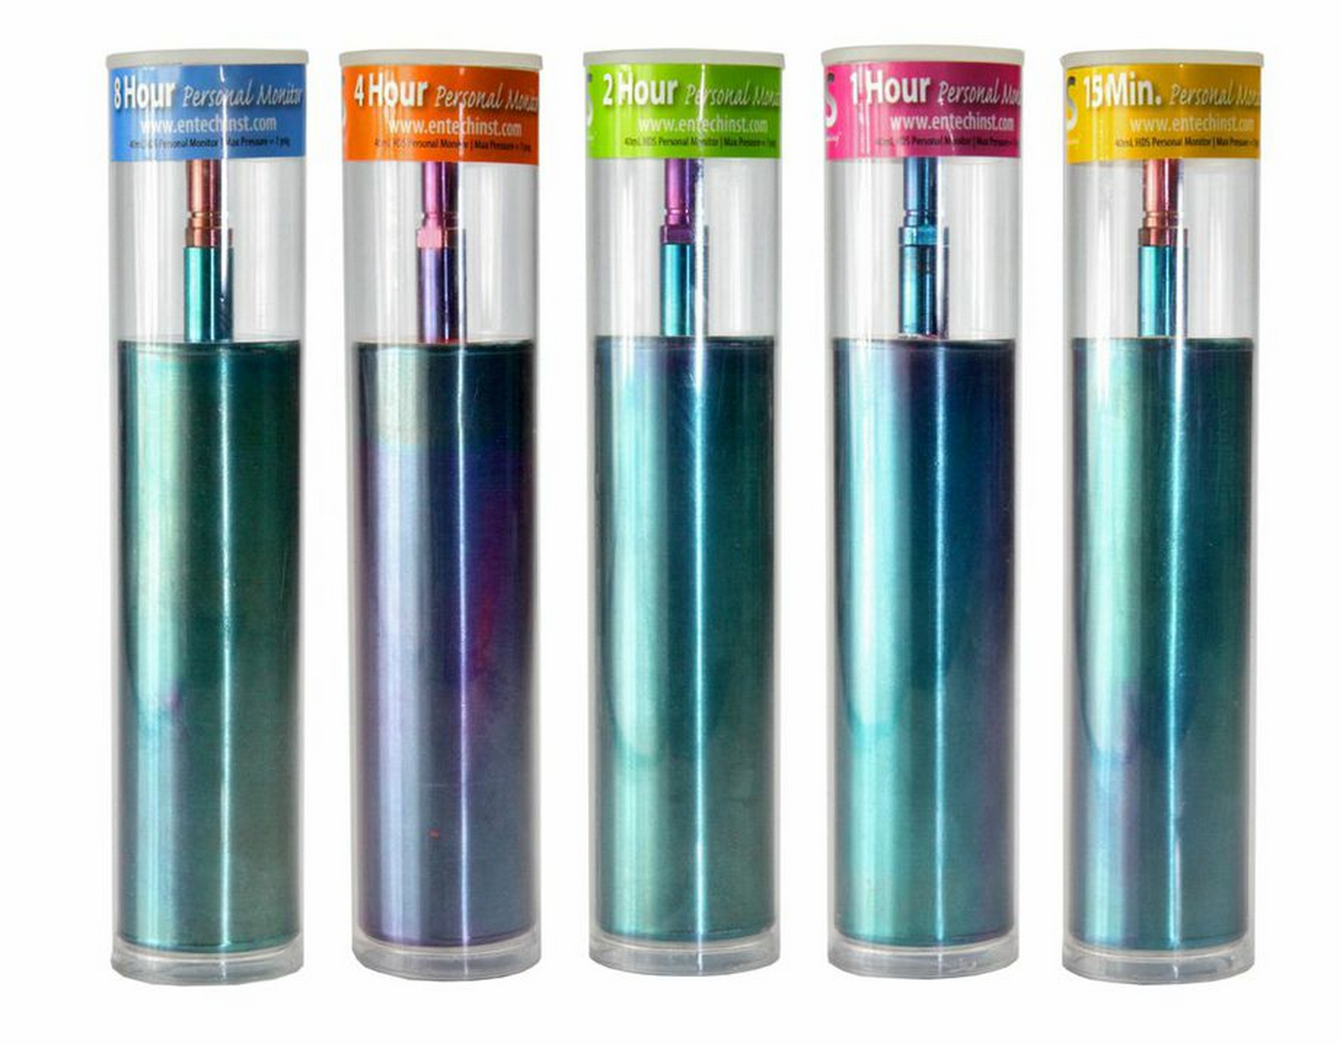
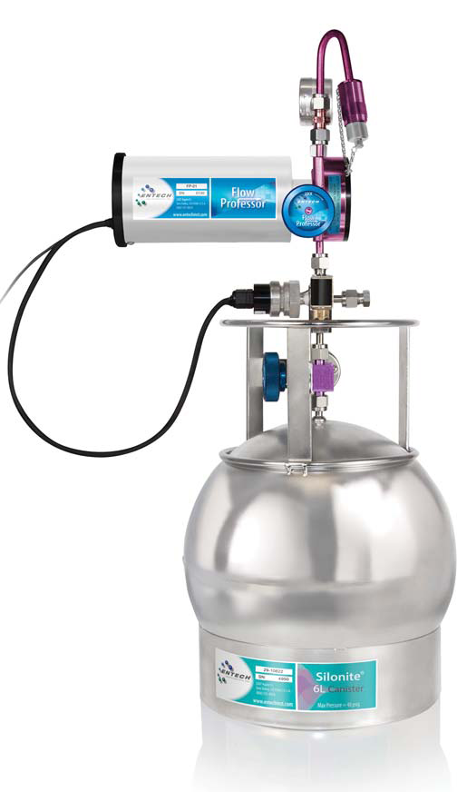
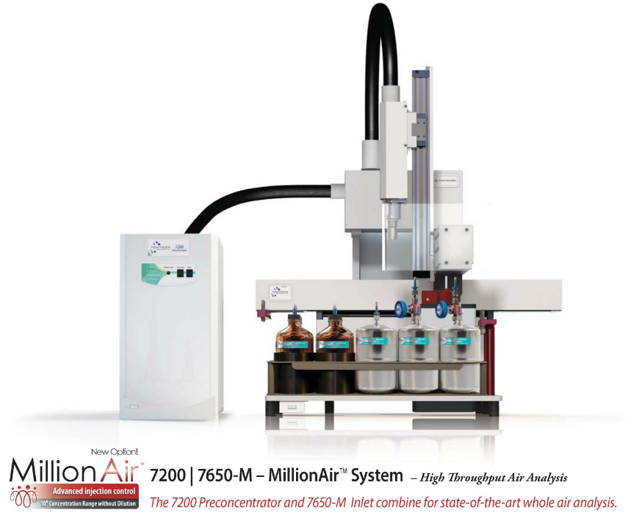
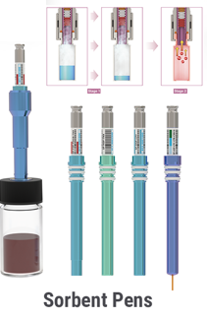
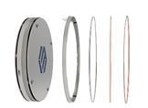
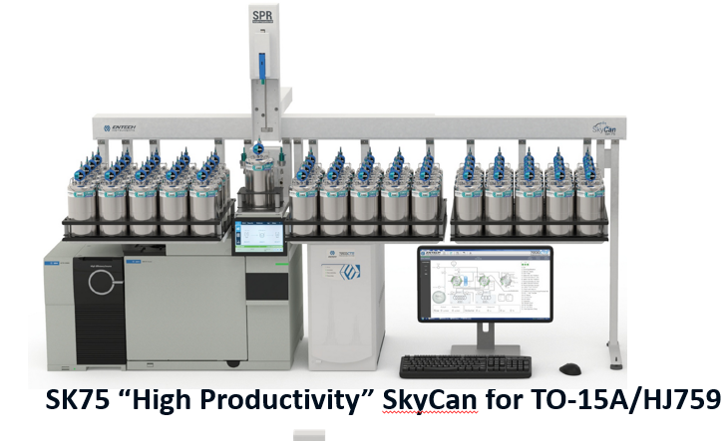
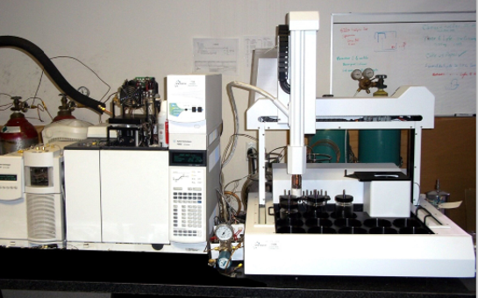
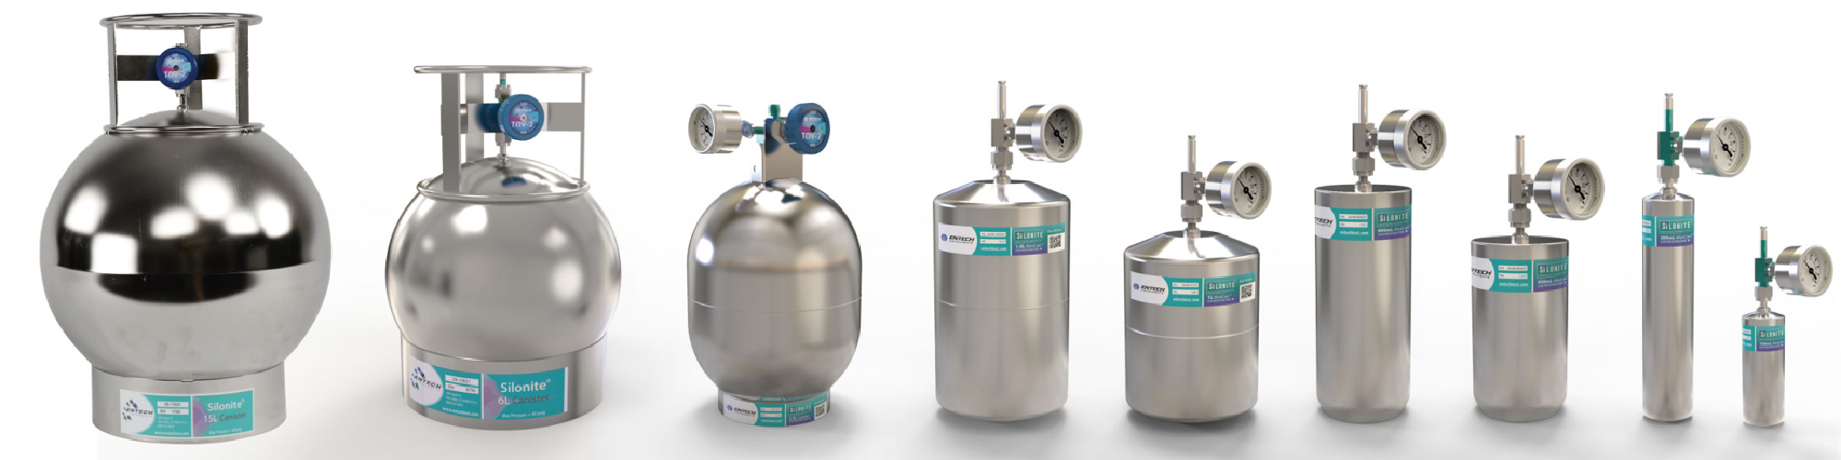
Entech Instruments Advanced
A Glimps of Sampling and Analysis Solutions Past and Present
4700
CS1200E
1900
7200/7650-M
HDS Monitors
3108DM
7016D
7650-HS
Flow Professor
Silonite Canisters

Slide 4

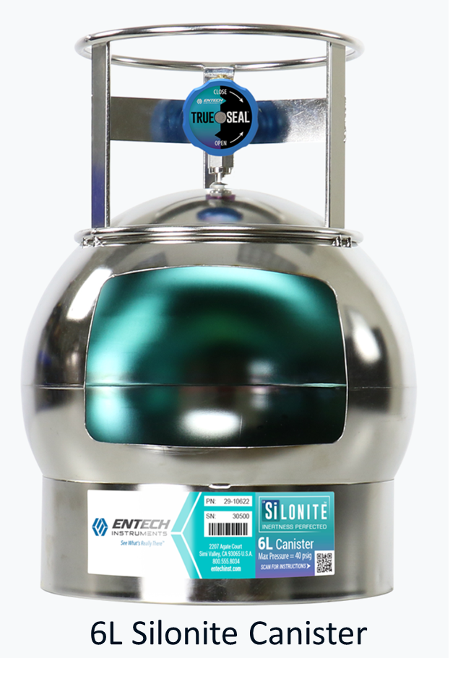
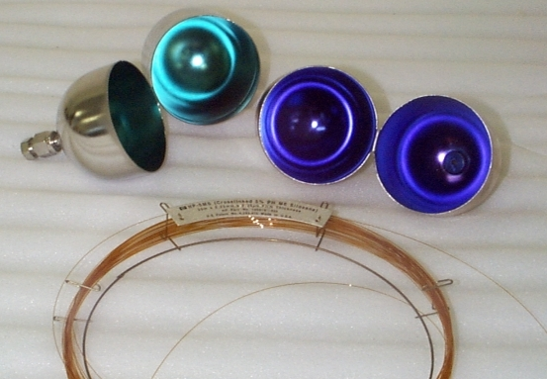
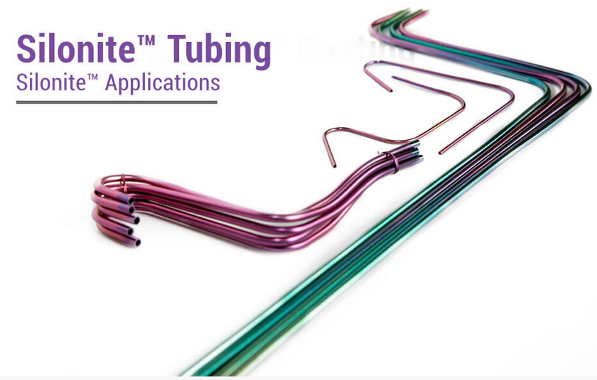
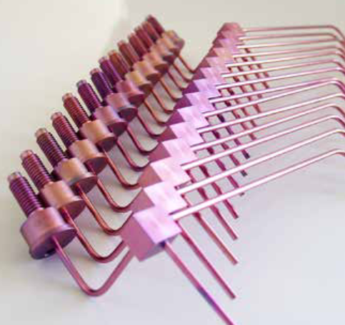
Advanced Silonite Ceramic Coatings Make Surfaces Inert Like GC Column
Makes Stainless Steel and Glass more inert / less adsorptive
All exposed surface coated (lines, fittings, valves, vacuum sleeves)
Silonite introduced in 1998 and still getting better!
Notes:
Coating Barrier prevents exposure
Coat all surfaces exposed to sample
Coating getting better

Slide 5
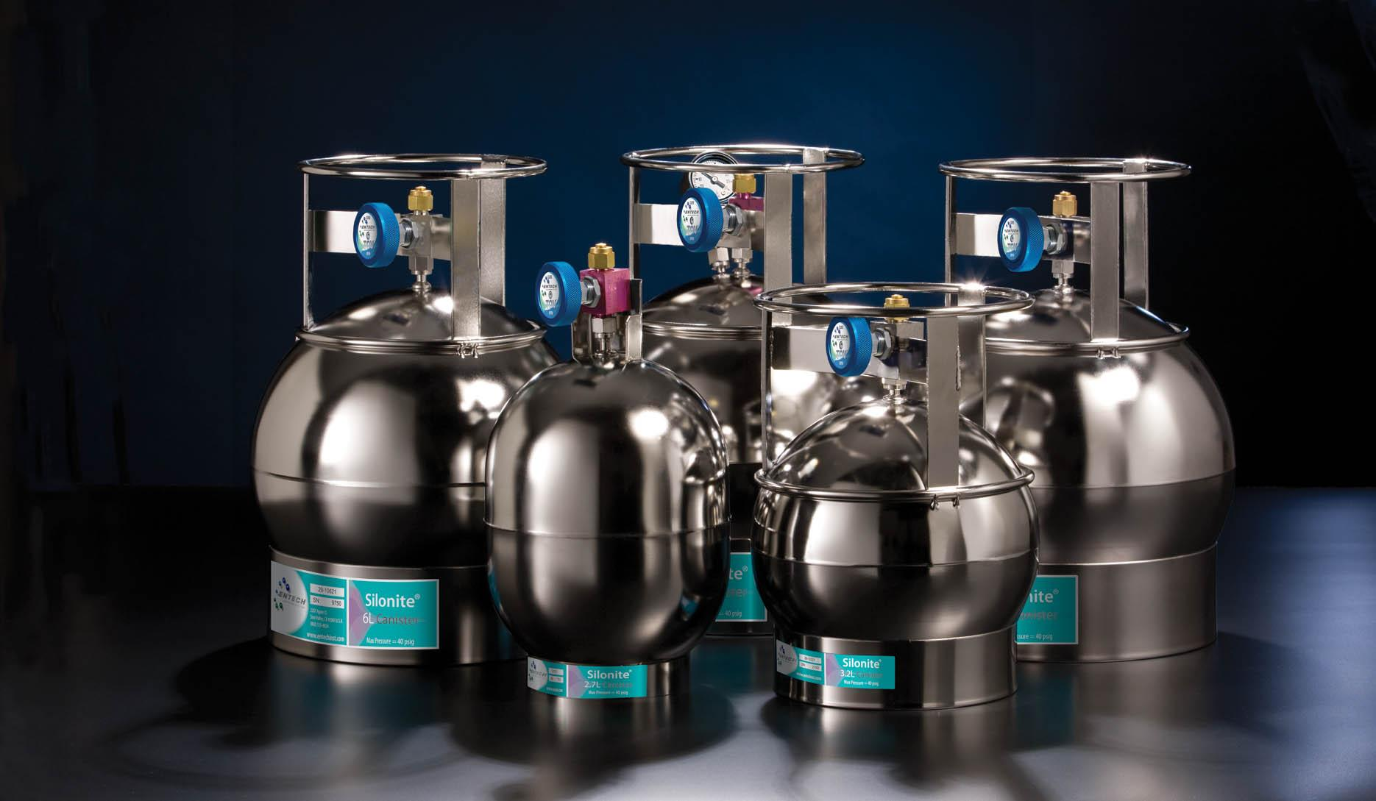
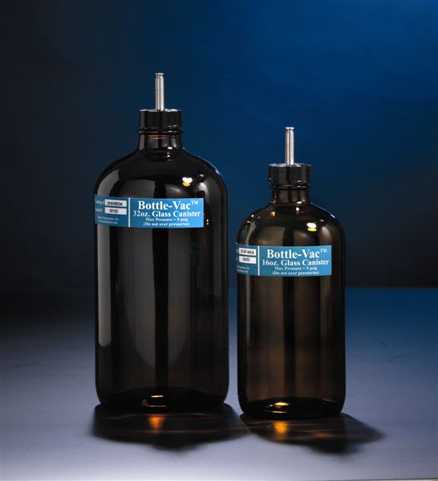
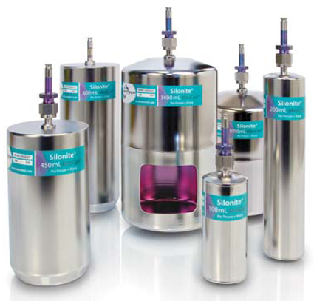
Canister Based Air Sampling and Analysis Method Across the Globe
US EPA Method TO14 (39 Non-Polar Hydrocarbons – 1988)
US EPA Method TO15 (Non-Polar and Polar VOCs – 1994/1999)
US EPA Method OTM-50, 30 PFAS Cmpds in Combustion Gas (Dec 2024)
Japan Ministry of the Environment, 1997, 9 Compounds
OSHA Method PV2120 – 2001 MiniCan Sampling in the Workplace
ASTM Method D5466 – 2007 (Similar to TO14)
Taiwan EPA Method NIEA-A715
China HJ 759-2015 (Jiangsu Province) 67 Compounds
Italy – ARPA 2002-2004
EU Utilization Increasing
2.7 to 15L Canisters
MiniCans -100cc to 1.4L
500cc-1000cc Bottle-Vacs

Slide 6
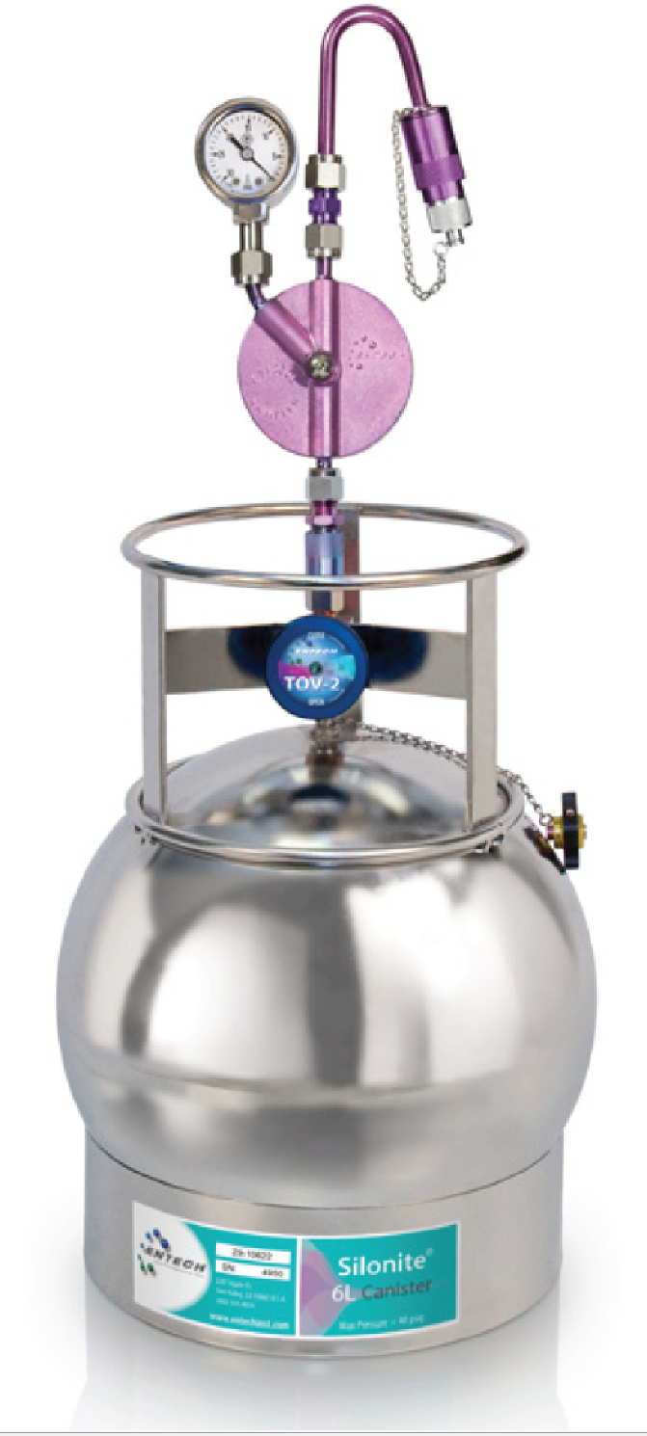
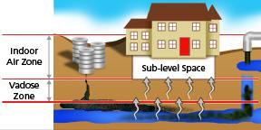
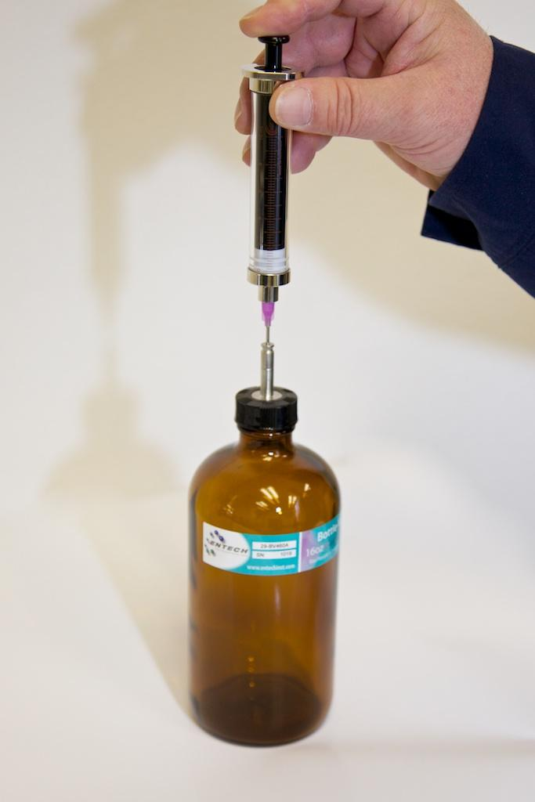
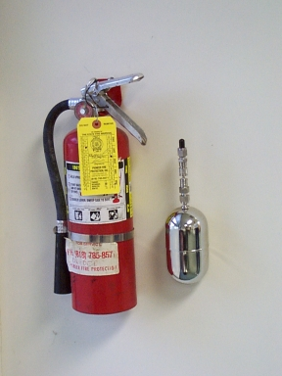
Silonite Coated Vacuum Sampling Canister Applications
  Air Toxic Compounds in US EPA Title III, 1990 CAAA
  C2-C10 Hydrocarbons for their effect on Ozone Generation
  Soil Gas, Vapor Intrusion, Ground Water Contamination Assessment
  Emergency Response for Accidental Releases
  Reduced Sulfur Compounds for Odor Monitoring
  Siloxanes in Digester gas
  Microbial VOCs (Mold Detection in Indoor Air)
  Workplace Monitoring – Solvents and Synthetic Precursors
Vapor Intrusion Monitoring
6L 24 Hr Time Integrated Sampler
Simple Gas Dilutions using Micro QT Valves
Emergency Sampling

Slide 7
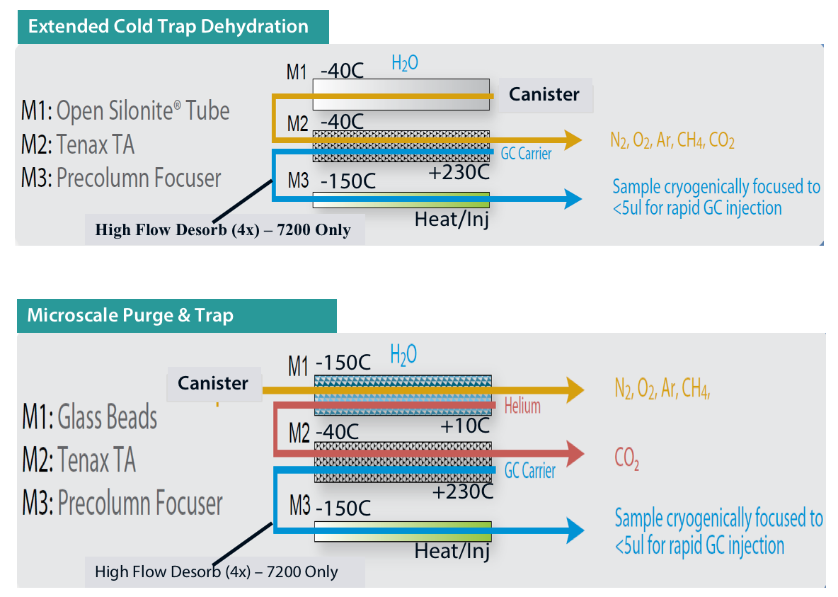

Entech 7000/7100 Canister Cryogenic Preconcentrators (1995-2005)
Early cryogenic trapping and water/CO2 management solutions were state of the art at the time
Both ECTD and MP&T were limited to C2-C12 Compound Range due to cold zone water knock-out
Not very green, as liquid nitrogen was not created locally, and even then should be used only if there are no other alternatives
Lower energy solutions that also extended the range to heavier analytes was needed
Entech 7200 Canister Preconcentrator
Water and CO2 Management Techniques

Slide 8
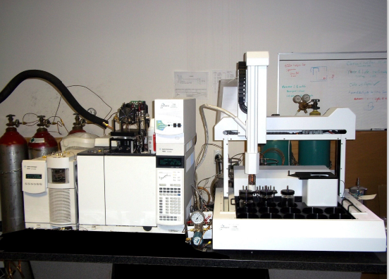

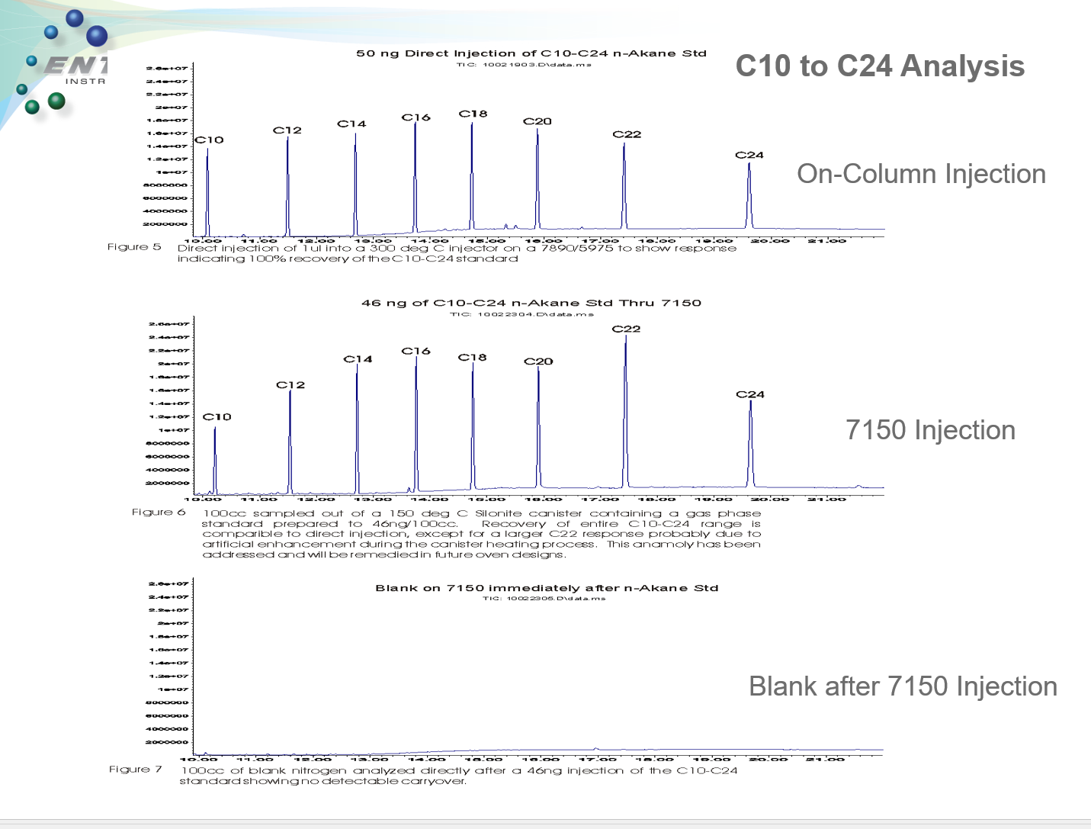
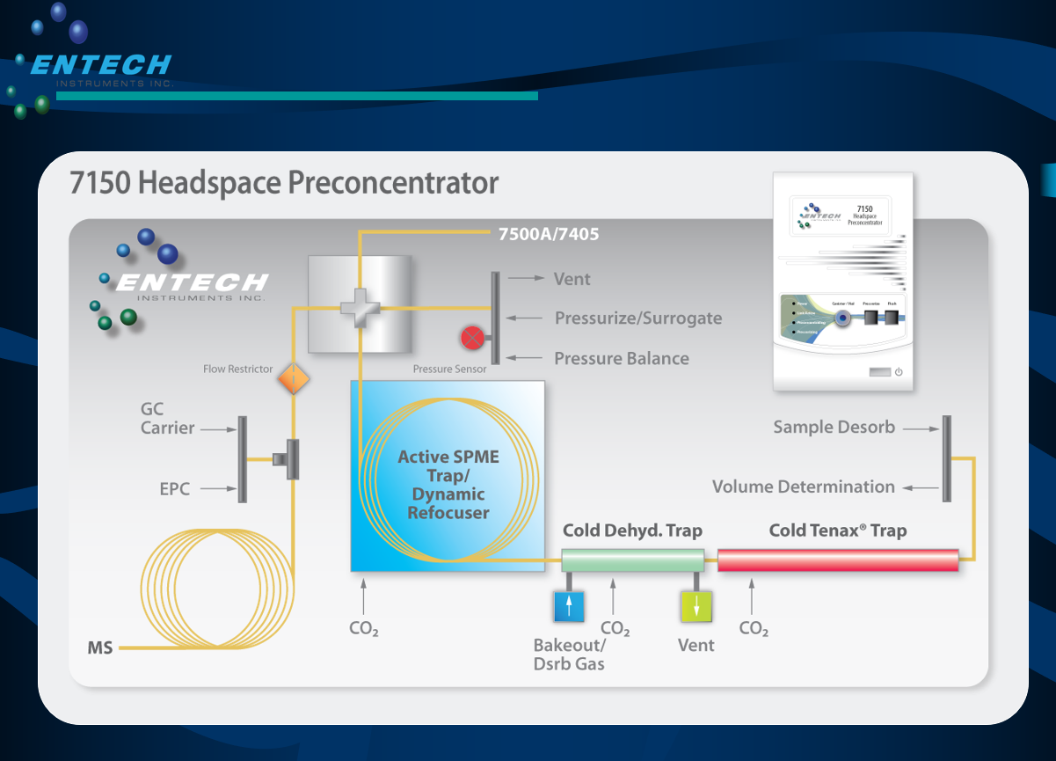
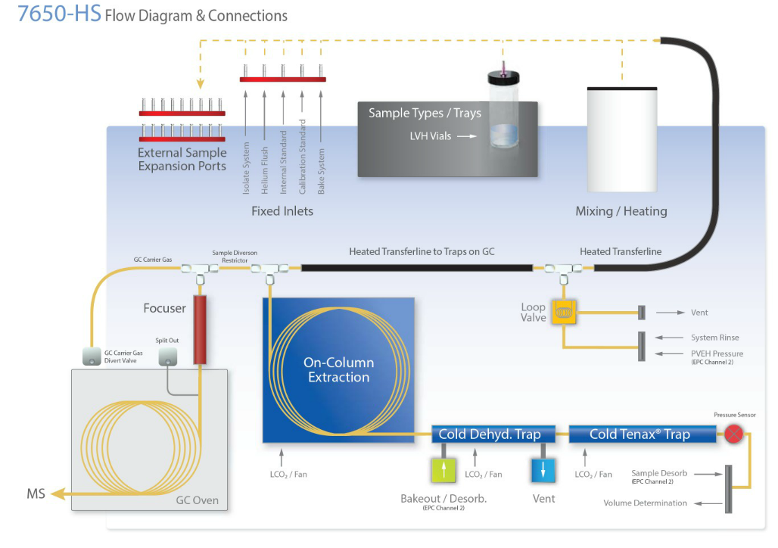
7500/7150 (2009) and 7650-HS (2014) Robotic Headspace w/ First Capillary Traps
The 7150 and later the 7650 added capillary columns to traps
  Improved efficiency
  Not just VOCs, but SVOCs out to C24

Slide 9
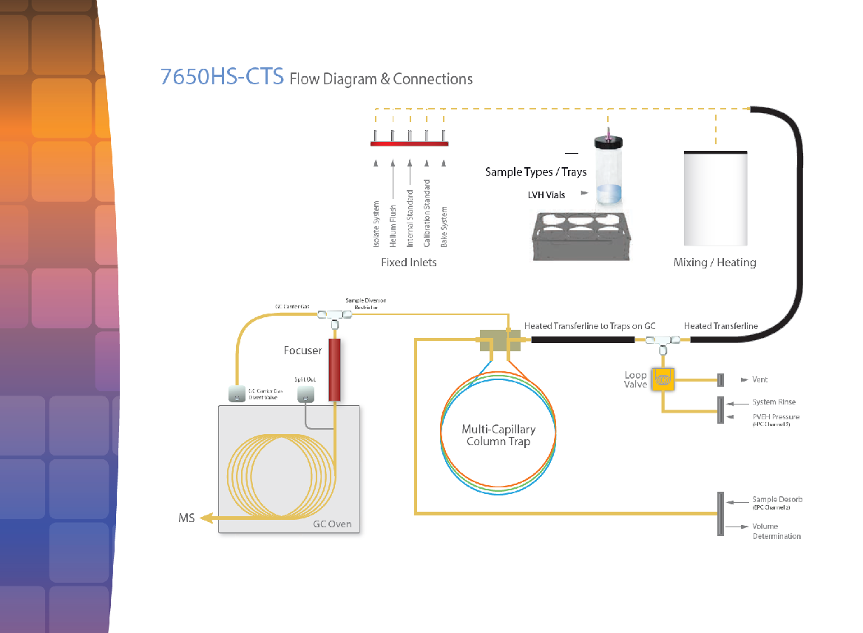
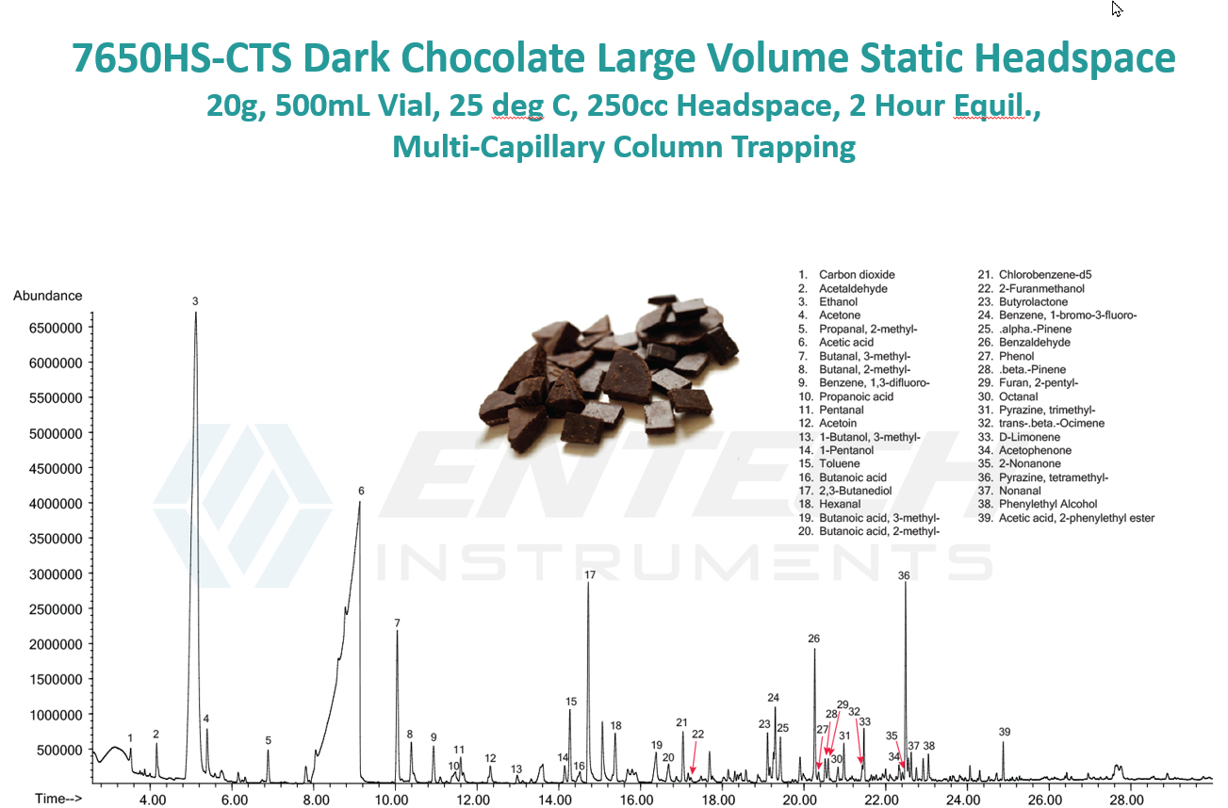
7650HS-CTS (2017) with 3-Stage Capillary Trap
The 7650HS-CTS used multiple capillary columns to greatly improve moisture elimination and polar compound recover
Used LN2 for final focusing, which was not optimal

Slide 10
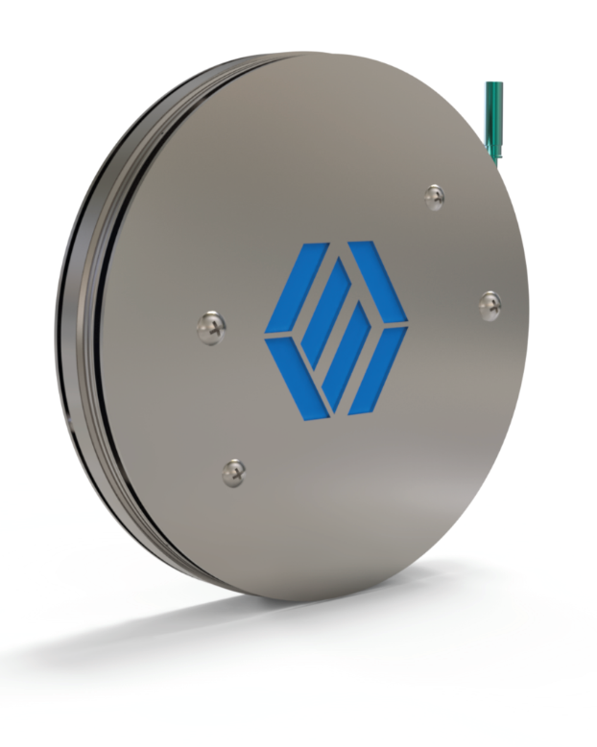
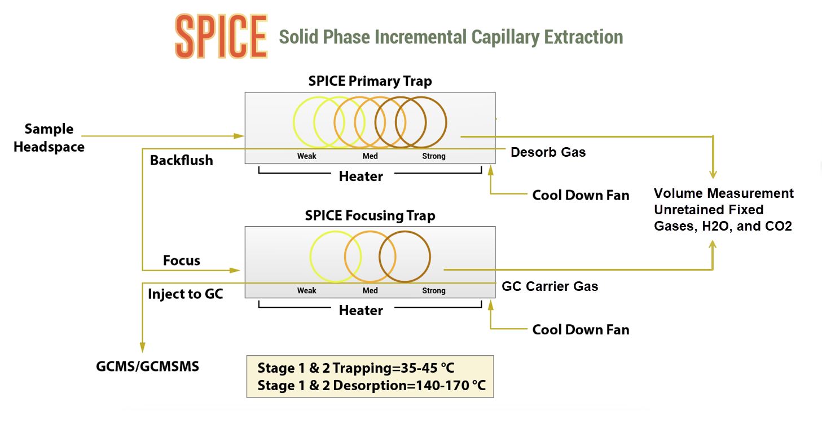
SPICE (2018)
Using GC Columns to Trap, Focus, and “Back-Flush” Samples to a GCMS for Maximum Compound Recovery
Soft adsorption-desorption like SPME, but sampled like DHS TD traps
  No reverse adsorption possible
3 Capillary columns with increasing strength in series, like multi-bed packed traps
Shorter segment SPICE trap perfect for focusing
Capillary sample prep for Capillary GC Column Analysis
If it’s in the headspace and boils over -40ºC, SPICE will recover it (except for H2O)

Slide 11
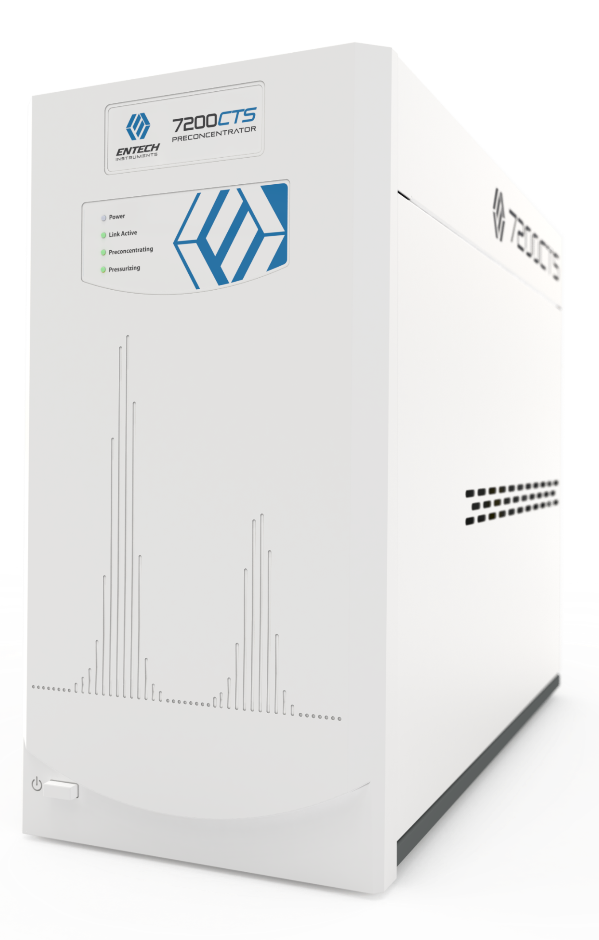
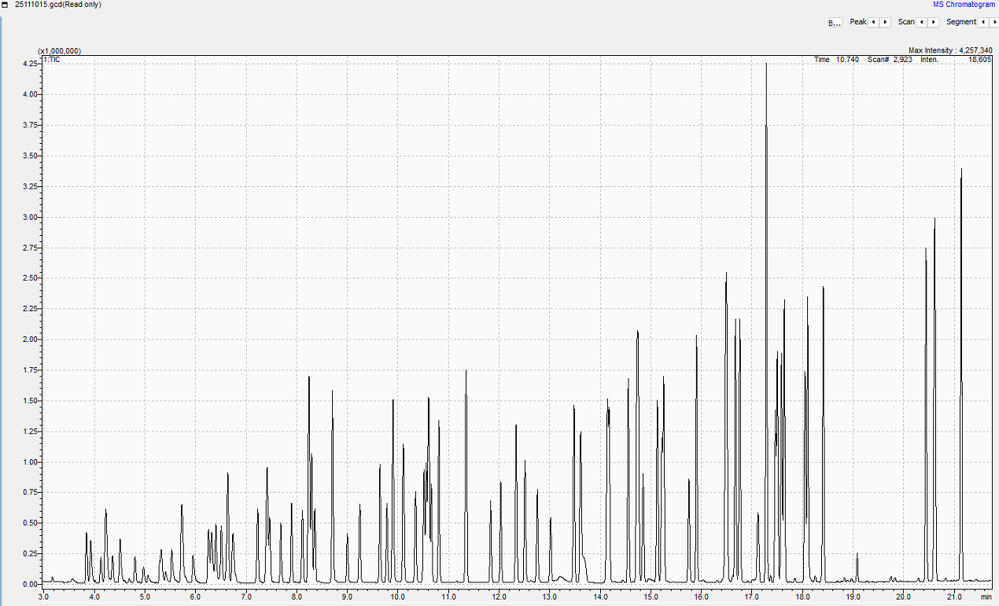
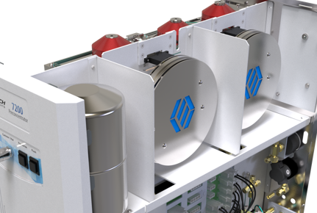
Consistent Peak Widths across a Boiling Point Range from -44ºC to +230ºC
(US EPA Method TO-15 Ambient Air Monitoring Standard)
TIC: 25111015
250 cc at 10 ppbv
Entech 200 CTS+/Shimadzu GC 2030 MS QP-2050
7200CTS

Slide 12
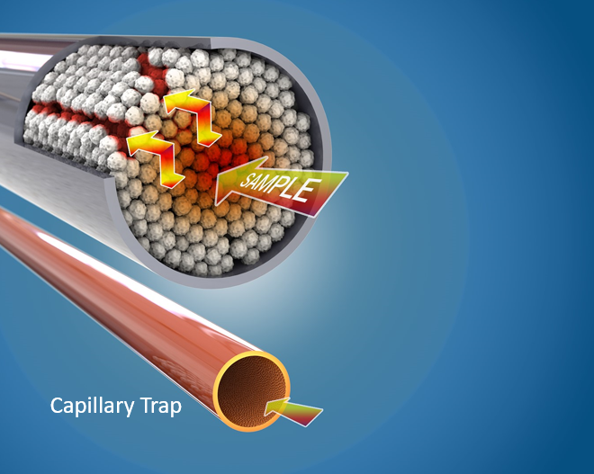
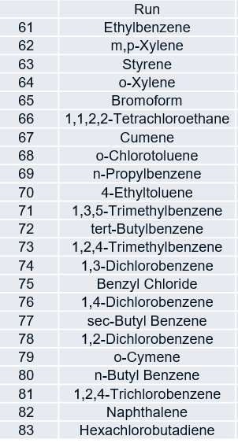
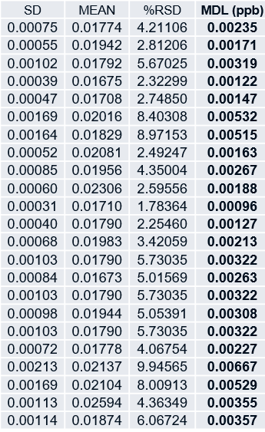
SPICE - Consistent Column Geometry Provides Exceptional Reproducibility
Packed Trap
MDLs: 7 Gas Std Replicates at 20 ppt, 250cc
Expansion/contraction of sorbent in packed traps causes inconsistency in trap geometry, with inconsistent channeling, creating recovery and carryover issues
No changes in the geometry of wall coated capillary columns due to repeated temperature cycling
Capillary Trap

Slide 13
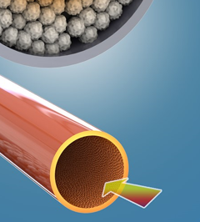
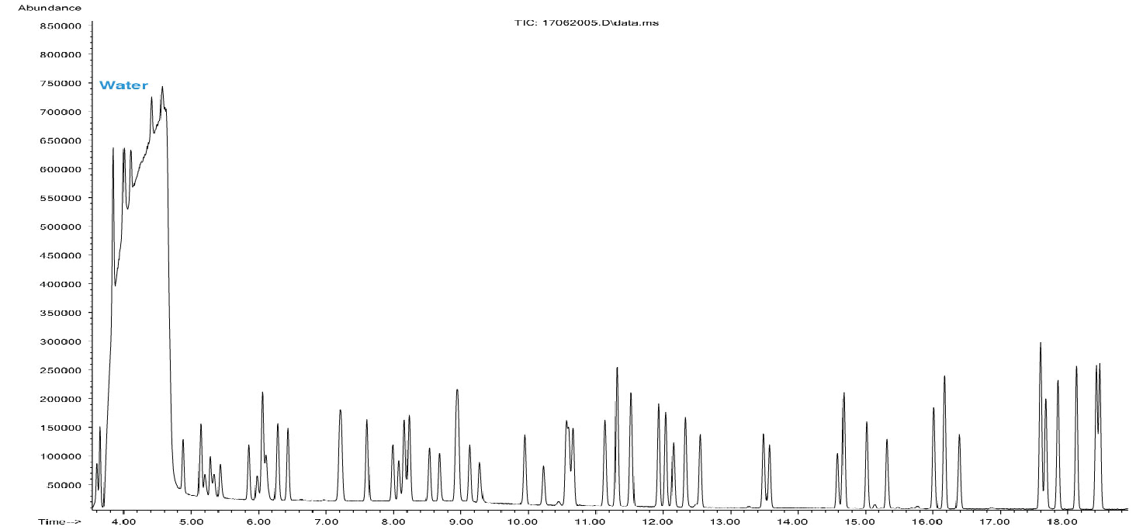
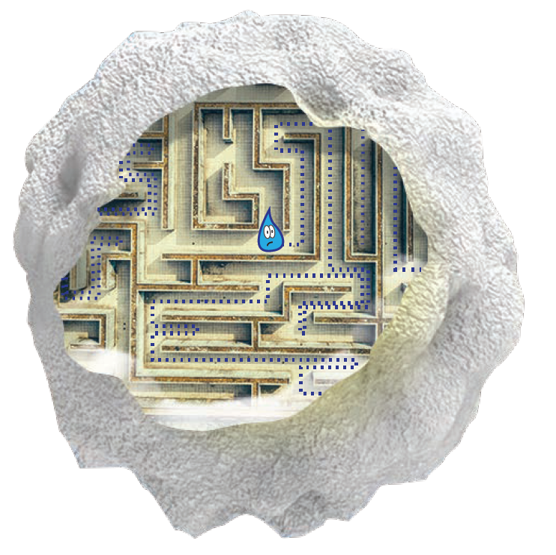
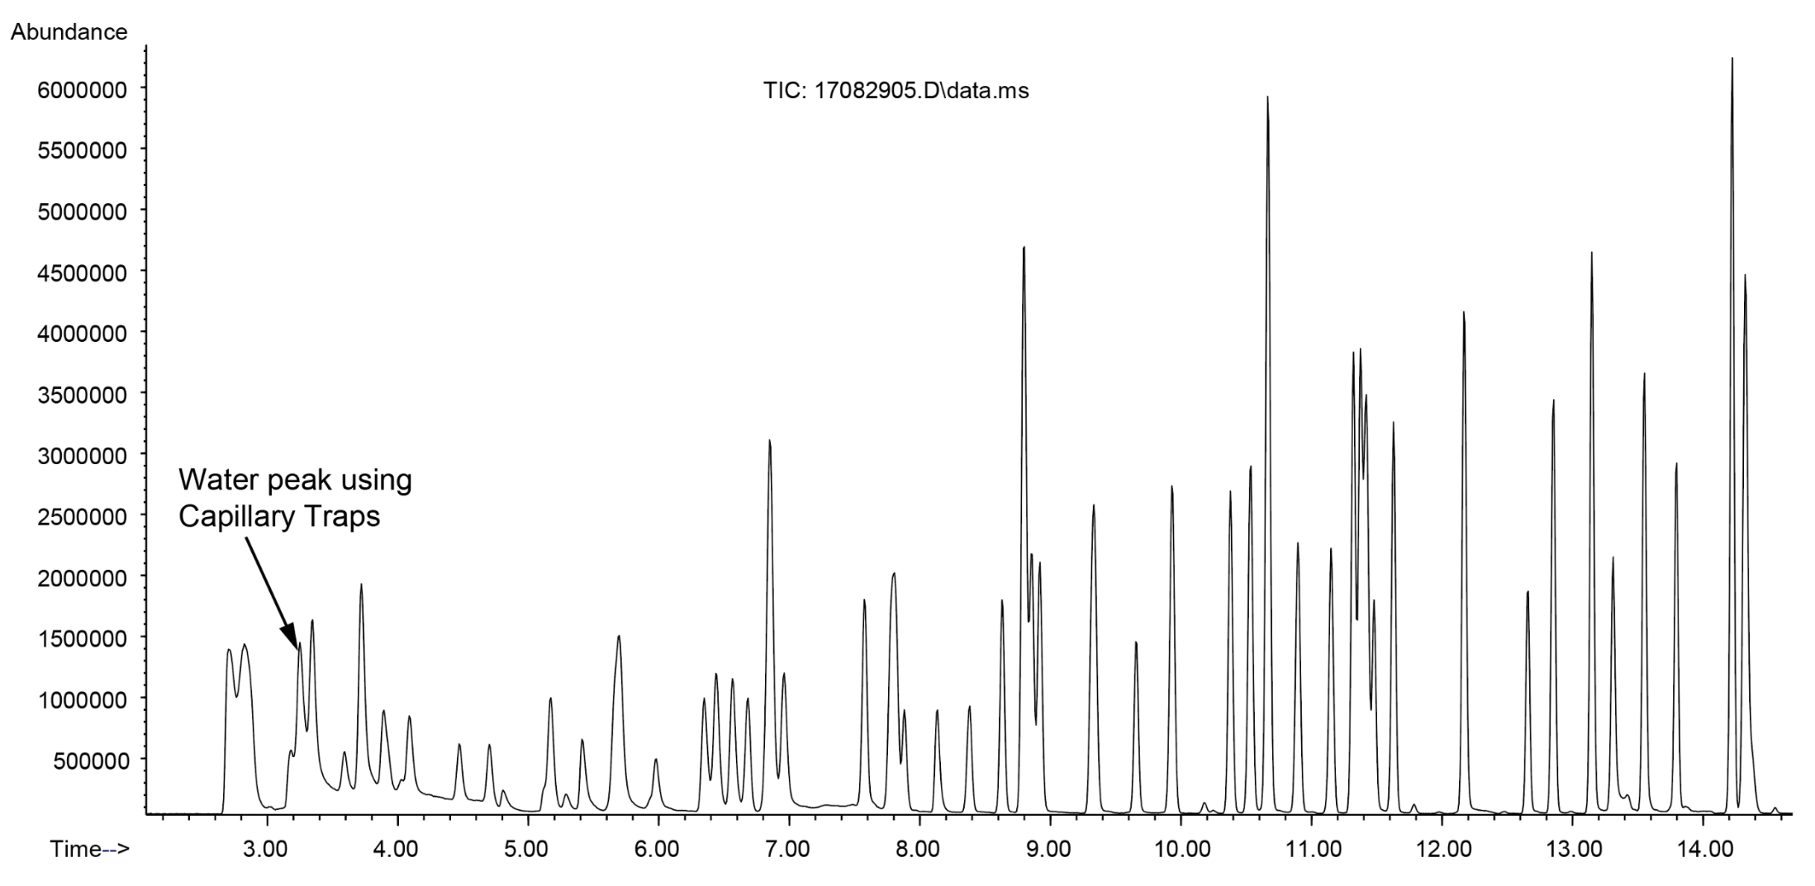
SPICE – Smaller Particle Size Means Faster Equilibration at a Given Temperature
(More Complete Dry Purging / Faster Injection Rates)
Typical Water peak using Packed Traps (70% RH, 250cc)
Capillary Trap Particle
Freon 12
Water peak using SPICE Capillary Traps (70% RH, 250cc)
Packed Trap Particle
Air

Slide 14
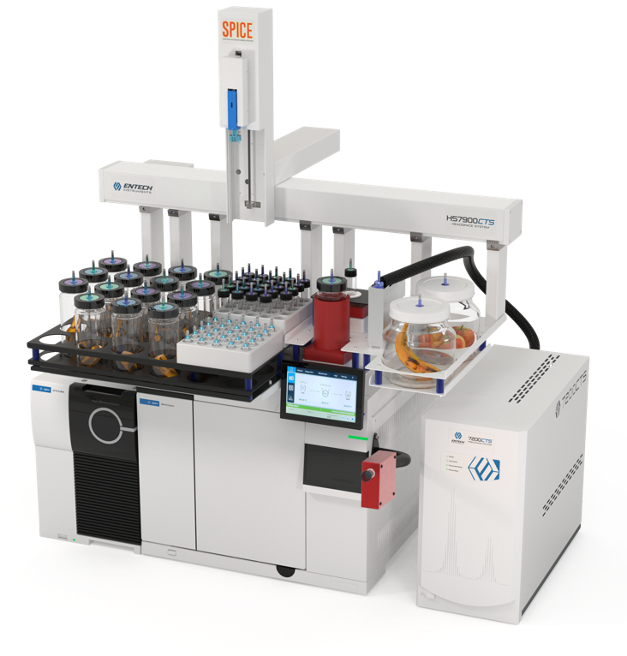

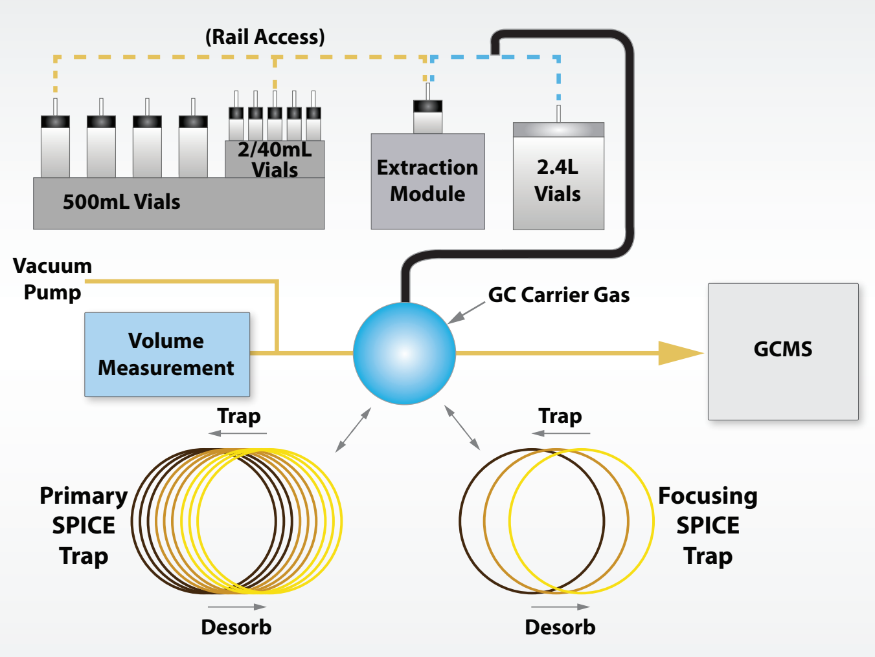
7900HS Using SPICE Dynamic Headspace Enrichment
Supports 2, 40, 500, and 2400cc vial sizes
30ºC to 80ºC Sample Heating Range
2-500cc Direct Volume Measurement

Slide 15


Compositional Analysis and Headspace “Snapshot”
to Fully Characterize Aromas in Samples
V-SPICE (Vacuum SPICE) – What is the Concentration of Aromas in the Matrix
Extracts under vacuum to recover and measure compounds in the liquid or solid matrix
Volatilizing matrix helps to sweep compounds to the SPICE Primary Trap
Final N2 Purge sweeps heavier analytes to the capillary trap.
LV-SPICE (Large Volume SPICE) –What are the Exact Concentrations a Consumer is Smelling?
Takes a “Snap Shot” of headspace at Full Static Equilibrium to accurately answer the question “What’s That Smell?”
Helps Quantify the Consumer Experience
  The Chemist “sees” exactly what the Consumer “smells”
In vial extractions (SPME) or adding purge gas (DHS) take the headspace out of equilibrium, over-representing heavier compounds

Slide 16

Compatible Vial Sizes - V-SPICE and LV-SPICE
LV-SPICE
V-SPICE
2mL 40mL 500mL 2400mL

Slide 17

LV-SPICE Duplicate Analysis of Strawberries to Evaluate Precision and Carryover
Low Carryover due to Small Particle Size and no Channeling Effects
10cc of equilibrated Strawberry headspace was analyzed using LV-SPICE
A Blank immediately following showed small siloxane column bleed peaks (like GC x GC) but no carryover peaks
10cc of headspace was analyzed again.
The first and third runs were almost identical
  slight increase in the heaviest compounds indicating full equilibrium had not quite been reached before the initial LV-SPICE analysis

Slide 18


LV-SPICE Analysis of 100cc and 10cc of Shampoo with Complex Matrix
7900HS, Agilent 8890/5977/HES, 60m x 0.25mm ID x 1.4um 624
GC profile is exactly the concentration presented to the consumer, from the lightest to the heaviest compounds
SPICE Focuser spreads compounds out while still desorbing rapidly. Not a point source focusing like LN2 Traps
  Compounds arrive at slightly different times on GC Column, reducing overloading
  Improves peak resolution even with complex matrices
Even 1,4-Dioxane forms a narrow, gaussian peak when many compounds are overloaded
1,4-Dioxane

Slide 19



V-SPICE Vacuum Analysis of Red Wine: 3-Column vs 2-Column SPICE Enrichment
7900HS, Agilent 8890/5977/HES, 60m x 0.25mm ID x 1.4um 624
Trapping with a standard 3 column SPICE trap causes Ethanol overloading of the GC column and MS with high alcohol containing samples.
Removing the last and strongest column allows Ethanol to be purged off
  Dimethyl Sulfide and other light odor/aroma compounds are maintained
  Another Capillary Trapping Advantage!!

Slide 20


Entech Sorbent Pen GCMS Sample Preparation Products – First Emerged in 2016
Sorbent Pen Goal:
  Find a Superior way to analyze VOCs thru SVOCs in a single analysis
  Force a vapor transition of all compounds through the headspace so GC remains clean, minimizing maintenance and down-time
  Thru 6-ring PAH Cmpds
  FSP HSP DSP ASP

Slide 21













The Brief History of Sorbent Pens, Systems, and Methods Development
2016 – VASE/Sorbent Pens Introduced. Performed like SPME but with the surface area of TD tubes
2017 – Manual VASE well established, SPR rail introduced, Analytical Scientist honors Entech with top 5 world wide analytical chemistry innovation awards
2018 – FEVE/FSP Pens introduced as a superior way to extract SVOCs from volatile liquids
2020-2021 – Improved VASE approach reduces aerosol exposure to outside of Pen, Flash-VASE and MA-VASE introduced. VXB extraction concept. Rail Controllers Optimized
2022 – On-Rail extraction design concepts started
2023 - 5800A and 3801A introduced. Analytical Chemistry Journal Publication on FEVE – Solvent Free SVOCs in Drinking Water
2024 – SPRINT Controllers Updated to SL2+, SPR40A optimized,
2025 – 5800A HiPer Liners Developed to optimize low flow transfer to GC. Combining Sorbent Pens with 7200CTS to provide extremely low detection limits for air monitoring including PFAS. Optimizing FEVE for solvent evaporation and 5mL water samples
2025 – VASE 2.0, Pen Sorbent Heated +10ºC vs sample vial.

Slide 22

Headspace Sorbent Pen Design Features
  Handle to allow SPR rail movement
  Microseal for vacuum creation and maintenance
  Redundant seals while sampling and desorbing
  Desorb gas flow port
  Inert ceramic “Silonite-SG” coated stainless steel
  Aerosol and “splash” protection
  Multi-bed options (PG30/Tenax/Carbopacks/Carboxen)
  No Moving Parts
  Axial Adsorption / Axial Desorption (backflushed)

Slide 23

Desorbing the Sorbent Pen Extract within 2 cm of the GC Column
The 5800A SPDU delivers the desorbed sample within 2cm of the GC Column
Rotary valves and transfer lines are eliminated
  No build up of oils, waxes, etc in flow path
Clean, Modular, Easier to service
GC oven and columns included in sample prep process

Slide 24



5800A Dual Column Operation
Integrating GC into the Sample Preparation Process
100%
SPLIT 1
100%
SPLIT 2

Slide 25


SPLT/SPLTLESS Desorption and Backflushing of Column 1
After Compounds of Interest Elute

Slide 26



VASE – Vacuum Assisted Sorbent Extraction
Performed like SPME but Under Vacuum with more Phase
Same Advantages as HS-SPME such as In-Vial extractions and desorption close to GC Column, plus
  Vacuum enhanced
  Greater durability
  Hundreds of times more Phase
  Extracts to equilibrium
    Adds consistency/sensitivity/increased recovery of low concentration compounds

Slide 27


VASE 2.0 (2025) – Keeping the Sorbent Warmer than the Sample
VASE 2.0 introduced in 2025 improves the consistency of VASE by ensuring no water collects on the Pens during extraction
Extraction rates remain maximized and consistent from Pen to Pen, and batch to batch
Sorbent Pen Temp: Sample Temp + 10C
Sample Temp 30 – 70 degC

Slide 28


VASE:
Volatile Fatty Acids in Water, 4 Hr Extraction, 50ºC, HSP-TNX
  VASE: Volatile Fatty Acids (VFAs) in Water – Clinical Biomarker of Interest

Slide 29
Odorants in Water - Olfactory Detection Limits at ng/L Levels
Compound | Odor Description | Typical Human Odor Threshold*
2-Methylisoborneol (2-MIB) | Musty, earthy | ~2–15 ng/L
Geosmin | Earthy | ~4 ng/L
2-Isopropyl-3-methoxypyrazine (IPMP) | Earthy/green pepper | ~1–2 ng/L
2-Isobutyl-3-methoxypyrazine (IBMP) | Earthy/green pepper | ~1–2 ng/L
2,4,6-Trichloroanisole (2,4,6-TCA) | Musty/moldy | ~0.1–2 ng/L
2,4,6-Tribromoanisole (2,4,6-TBA) | Musty, moldy (corky) | ~0.1–10 ng/L with some reports at very low values (~0.08–0.3 ng/L)
Detection of Trihaloanisols to 0.1ng/L can be important to account for odor synergy when mixed Chloro/Bromo THAs are present
*Odor threshold concentrations vary by study and method, and individual human sensitivity can differ—but the ranges below are representative from several scientific peer-reviewed journals, including:
Sesha Pochiraju S, Hoppe-Jones C, Adams C, Weinrich L. Development and optimization of analytical methods for the detection of 18 taste and odor compounds in drinking water utilities. Water Res X. 2021 Mar 24;11:100099. doi: 10.1016/j.wroa.2021.100099. PMID: 33889833; PMCID: PMC8050797.

Slide 30
0.1 to 100 ng/L Quantitation for All 6 Odorants, SIM
External Calibration Curve (ng/L)
Analyte | Rt (min) | Qion | 0.1 | 0.5 | 1 | 5 | 50 | 100 | R² | Slope | Intercept
IPMP | 7.664 | 137 | 1225 | 6810 | 11113 | 47456 | 523787 | 968607 | 0.9985 | 9789 | 4332
IBMP | 8.452 | 124 | 1974 | 8986 | 18021 | 59215 | 674603 | 1314993 | 0.9998 | 13191 | 2017
2-MIB | 8.456 | 95 | 1443 | 3350 | 5450 | 16763 | 105597 | 218519 | 0.9991 | 2140 | 2669
TCA | 9.648 | 195 | 1077 | 3748 | 7985 | 29096 | 341316 | 647605 | 0.9993 | 6527 | 1463
Geosmin | 10.238 | 112 | 1218 | 5918 | 12528 | 42016 | 448694 | 811460 | 0.9976 | 8213 | 5956
TBA | 11.549 | 346 | 187 | 1162 | 2193 | 8784 | 96473 | 169364 | 0.9959 | 1724 | 1371
VASE Extraction
HSP: Tenax TA
Sample volume: 25 mL
Extraction temp (˚ C): 70
RPM: 150
Duration (h): 16
Analysis: SPR40/5800A/7890/5977
Thermal Desorption: 3 min at 260 ˚ C
Mode: SPLT/SPLTLESS
Flow rate: 1.2 mL/min
Focusing column: DB5MS 2m x 0.25 mm x 0.25 µm
GC column: DB5MS 30m x 0.25 mm x 0.25 µm
MS mode: Selective Ion Monitoring (SIM)
Runtime (min): 17

Slide 31



Immediate Re-run of 100 ng/L HSP Shows 0.04 ppt Carryover of TBA
No Net Flow during VASE sampling, so no purge gas steering forces exist to push analytes through channels that formed during last cooling event.
Heavier compounds stay close to trap entrance where they are fully recovered, reducing carryover

Slide 32
Percent Carryover is 0.09 % or Less for All Analytes
 |  | Abundance (SIM)
 |  | HSP ID | 411-4101 | 411-2342 | 411-2342
 |  | Data file | 260128_C1_03 | 260128_C1_08 | 260128_C1_09
Analyte | Rt (min) | Qion | 0.1 ng/L | 100 ng/L | 100 ng/L Re-run | Carryover (%)
IPMP | 7.664 | 137 | 1225 | 968607 | 856 | 0.09
IBMP | 8.452 | 124 | 1974 | 1314993 | 898 | 0.07
2-MIB | 8.455 | 95 | 1443 | 218519 | 47 | 0.02
TCA | 9.648 | 195 | 1077 | 647605 | 353 | 0.05
Geosmin | 10.238 | 112 | 1218 | 811460 | 660 | 0.08
TBA | 11.549 | 346 | 187 | 169364 | 66 | 0.04

Slide 33
Tap Water Spike Triplicates Result in RSDs from 1.9-9.4 %
Spike Recovery Report, Tap Water (ng/L)
Analyte | Unspiked | Spiked 5 ng/L Rep1 | Spiked 5 ng/L Rep2 | Spiked 5 ng/L Rep3 | Rep Ave | Rep Std Dev | Rep RSD (%)
IPMP | <0.1 | 4.18 | 4.38 | 4.03 | 4.20 | 0.1783 | 4.2
IBMP | <0.1 | 4.98 | 5.12 | 4.61 | 4.91 | 0.2652 | 5.4
2-MIB | 3.48 | 7.99 | 8.09 | 7.79 | 7.96 | 0.1543 | 1.9
TCA | <0.1 | 4.97 | 5.27 | 5.03 | 5.09 | 0.1554 | 3.1
Geosmin | <0.1 | 3.93 | 4.57 | 4.42 | 4.31 | 0.3325 | 7.7
TBA | <0.1 | 4.59 | 5.13 | 4.26 | 4.66 | 0.4400 | 9.4
Abundance
260129_C1_02.D\data.ms
260129_C1_03.D\data.ms
260129_C1_04.D\data.ms
m/z 195 for TCA
26000
260129_C1_05.D\data.ms
260129_C1_07.D\data.ms
22000
18000
 | Unspiked
 | 5 ng/L spike Rep1
 | 5 ng/L spike Rep2
 | 5 ng/L spike Rep3
 | 5 ng/L Standard
14000
10000
6000
2000
0
9.52
9.56
9.60
9.64
9.68
9.72
9.76
9.80
Time (min)

Slide 34

🍷 Odorants in Wine – Applying Same Calibration Factors as Water During Matrix Addition to See EtOH Affects on Recovery
IPMP and IBMP are very well known in wine chemistry.
Responsible for “green,” “bell pepper,” “herbaceous,” “asparagus” notes
Sources in wine: Naturally synthesized in grape berries.
Typical concentrations: ~1–50 ng/L
TCA and TBA are responsible for infamous “cork taint”
Sources in wine: Corks, Winery materials (barrels, pallets, cardboard, sealants); microbial methylation of halophenols
Odor impact: Detectable at sub-ppt to low-ppt levels, often ruining wine even when chemically “clean.”
Spike Recovery Report, Wine (Cabernet Sauvignon, 1:10 in Water, ng/L)
Analyte | Unspiked | Spiked 5 ng/L
IPMP | 1.73 (17.3 with dilution factor) | 7.79
IBMP | <1 | 3.90
2-MIB | <1 | 4.37
TCA | <1 | 4.43
Geosmin | <1 | 4.18
TBA | <1 | 4.13

Slide 35


PFAS in Water using VASE
PFCAs - Perfluoro Carboxylic Acids FTOH – Fluorotelomer Alcohols

Slide 36


VASE Recovery of PFAS in 25mL of Water, 1-16Hr, 70ºC
(Zero Water Collected Verified by Zero Weight Gain)

Slide 37


PFAS in Water using VASE (25mL/16Hr): Linearity and Calculated MDLs
SPR40A/5800A – Thermo 1310/7000 GCMS, SIM Mode, TG200, 1um Col 1-2

Slide 38





FEVE – Full Evaporative Vacuum Extraction
Volatile sample completely evacuated through the Sorbent Pen
Extracts 30 samples simultaneously
2mL FEVE
  10 – 1000ul of aqueous, water/alcohol, or solvents
  No pre-cleanup
  All non-volatile contaminants remain in the vial
  Run hundreds of samples without liner/column maintenance
6mL FEVE for Drinking Water
  No solvents, no blow down.

Slide 39


FEVE – Full Evaporative Vacuum Extraction
Volatilize the entire matrix through the sorbent using vacuum at 30-40ºC
Heat vials to 150-250C under vacuum to complete recovery of heaviest target compounds

Slide 40

SVOCs in 5 mL Drinking Water – Direct FEVE Analysis
2 m × 0.25 mm × 0.25 µm Column 1
DIMP and Isophorone Split 5:1
All other compounds splitless during Column 1 to 2 transition
Sensitivity equivalent to 1ul injection of a 5L water sample size

Slide 41








EPA Method 525.3 - Wide Variety of Compound Classifications
No Matrix Competition – No Recovery Differences w/ Polar and Non-Polar Cmpds
Recovery vs Target Compound Polarity
Full Immersion

Slide 42

C10-C30 Alkanes in Hexane/Ethyl Acetate, FEVE, 100ul

Slide 43


C10-C30 Alkanes: FEVE Linear Response from 10-150ul

Slide 44


FEVE Human Plasma Sample Preparation-Exposomics Lab Study
Low Volume “Non-DCM” Solvent Extraction – No Cleanup
Sample Preparation
FEVE and 5800A- 7890/5977 GCMS (Single Quad)
Thaw sample to room temperature, vortex and aliquot 100 µL to GC vial
Add 200-1000 µL extraction solvent , 4:1, hexane: ethyl acetate (considering Cyclohexane or Methyloxolane Options)
Add 20 µL formic acid
Cap vial, vortex, sonicate for 1 hr
Let samples sit for 20 min (or centrifuge)
Add ISTD to FEVE vial
Transfer aliquot of supernatant to FEVE vial
Assemble vacuum sleeve and FSP
Automated FEVE
Transfer FSPs to Sorbent Pen Tray and start automated thermal desorption / GCMS SIM Mode Analysis
Current Technique | FEVE (25x less dilution!)
100 µL plasma -> 200 µL extraction solvent (2x) | 100 µL plasma -> 200 µL extraction solvent (2x)
200 µL -> 150 µL supernatant (0.75x) | 200 µL -> 150 µL supernatant (0.75x)
150 µL -> 6 µL injection (25x) | 150 µL injection
Total Dilution = 37.5 | Total Dilution = 1.5

Slide 45

Fatty Acids and Cholesterol Overloading when Injecting 100ul of Extract

Slide 46



Recovery: Triplicate 1 ppb Blood Plasma Spike in QC Pool Full Scan
(Hexane/Ethyl Acetate/Formic Acid Extraction, 800ul FEVE, SPR40A/5800A/7890/5977)
 | ISTD Name | Rt (min) | Qion | Response |  |  | Average | Std Dev | %RSD
 |  |  |  | 241031_07.D | 241031_08.D | 241031_09.D
1 | 1,4-Dichlorobenzene-d4 | 6.814 | 150 | 365288 | 466760 | 391448 | 407832 | 52683 | 12.9
2 | Naphthalene-d8 | 8.621 | 136 | 3763758 | 4062049 | 4103867 | 3976558 | 185473 | 4.7
3 | Acetanapthlene-d10 | 11.083 | 162 | 2040044 | 2130968 | 2149623 | 2106878 | 58627 | 2.8
4 | Phenantrene-d10 | 13.953 | 188 | 3186683 | 3347309 | 3585760 | 3373251 | 200799 | 6.0
5 | Chrysene-d12 | 21.619 | 240 | 2616408 | 2810550 | 2534499 | 2653819 | 141777 | 5.3
6 | Perylene-d12 | 25.943 | 264 | 3323986 | 3539550 | 3408136 | 3423891 | 108642 | 3.2
 | Analyte Name | Rt (min) | Qion | Response |  |  | Average | Std Dev | %RSD
 |  |  |  | 241031_07.D | 241031_08.D | 241031_09.D
1 | 2-Chlorobiphenyl | 11.192 | 188 | 39355 | 43951 | 39430 | 40912 | 2632 | 6.4
2 | 4-Chlorobiphenyl | 11.909 | 188 | 32614 | 39224 | 33820 | 35219 | 3520 | 10.0
3 | 2,4'-Dichlorobiphenyl | 13.045 | 222 | 24402 | 30132 | 26502 | 27012 | 2899 | 10.7
4 | Hexachlorobenzene | 13.163 | 284 | 14075 | 14127 | 13523 | 13908 | 335 | 2.4
5 | 2,2',5-Trichlorobiphenyl | 13.871 | 186 | 12493 | 13436 | 13128 | 13019 | 481 | 3.7
6 | 2,4,4'-Trichlorobiphenyl | 14.889 | 256 | 16072 | 17898 | 18608 | 17526 | 1308 | 7.5
7 | 2,2',3,5'-Tetrachlorobiphenyl | 15.633 | 292 | 12551 | 13856 | 11744 | 12717 | 1066 | 8.4
8 | 2,2',5,5'-Tetrachlorobiphenyl | 16.088 | 292 | 11965 | 11713 | 13280 | 12319 | 841 | 6.8
9 | 2,3',4',5-Tetrachlorobiphenyl | 17.032 | 292 | 18189 | 16957 | 17050 | 17399 | 686 | 3.9
10 | p,p'-DDE | 18.331 | 246 | 20037 | 19376 | 17900 | 19104 | 1094 | 5.7
11 | 2,3,3',4',6-Pentachlorobiphenyl | 18.513 | 326 | 21691 | 24043 | 20167 | 21967 | 1953 | 8.9
12 | 2,2',3,4,4',5'-Hexachlorobiphenyl | 19.076 | 360 | 11338 | 12594 | 11407 | 11780 | 706 | 6.0
13 | 2,3',4,4',5-Pentachlorobiphenyl | 19.176 | 326 | 22569 | 18179 | 19670 | 20139 | 2232 | 11.1
14 | p,p'-DDD | 19.367 | 235 | 47436 | 49288 | 53261 | 49995 | 2976 | 6.0
15 | 2,2',3,4',5',6-Hexachlorobiphenyl | 19.694 | 360 | 14903 | 13600 | 14381 | 14295 | 656 | 4.6
16 | 2,2',4,4',5,5'-Hexachlorobiphenyl | 20.348 | 360 | 16504 | 15829 | 15096 | 15810 | 704 | 4.5
17 | 2,2',3,4,4',5,5'-Heptachlorobiphenyl | 21.992 | 394 | 13260 | 13149 | 12294 | 12901 | 529 | 4.1

Slide 47

Carryover Study: Blank After QC Pool Injection
Demonstrates Clean Pens so no Further Bakeout Needed
800/1000 µL aliquot of 100 µL QC Pool Sample

Slide 48


Optimizing Solvent Extraction Volumes for 100ul of Blood Plasma
Comparison of Recoveries using different extraction volumes and FEVE Injection Volumes
    800 of 1000 µL (80%) – 2 mL glass vial
    200 of 400 µL (50%) – 2 mL glass vial
    150 of 200 µL (75%) – 350 µL glass vial with insert
1000 µL
400 µL
200 µL

Slide 49

Full Scan: Replicates at 800/1000 and 200/400 µL
Similar percent recoveries observed for 800/1000 µL and 200/400 µL
800/1000 µL provided maximum sensitivity so was used for the study

Slide 50



Robustness: Stable ISTD Recoveries After >1 Month of Injections with NO MAINTENANCE (>60 800 µL Plasma Extracts, Equv to 4800 1ul SSL Inj.)
Liner still looks like NEW!
 | ISTD | Rt (min) | Qion | Average (Inj 1-4 & 21-24 on 241031) | Std Dev | %RSD
1 | 1,4-Dichlorobenzene-d4 | 6.814 | 150 | 357109 | 72300 | 20.2
2 | Naphthalene-d8 | 8.621 | 136 | 3819487 | 405111 | 10.6
3 | Acetanapthlene-d10 | 11.083 | 162 | 2004550 | 218516 | 10.9
4 | Phenantrene-d10 | 13.953 | 188 | 3646547 | 381262 | 10.5
5 | Chrysene-d12 | 21.619 | 240 | 2885054 | 305001 | 10.6
6 | Perylene-d12 | 25.943 | 264 | 3542277 | 203385 | 5.7

Slide 51

EPA Method 625 SVOCs in Wastewater using FEVE Without DCM
Addition of 17% Acrylonitrile, Vortex, (Centrifuge), 100ul FEVE, 10:1 Split

Slide 52
FEVE SVOCs in Wastewater Without DCM: Linear Response
All Bases, Acids, and Neutrals Recovered at a Neutral pH
625 Analyte | Rt (min) | Qion | Abundance |  |  |  |  | R2
 |  |  | 25 µL | 50 µL | 100 µL | 150 µL | 200 µL
Bases/Neutrals
bis(2-Chloroisopropyl) ether | 7.47 | 45 | 63274 | 108083 | 187119 | 266267 | 351233 | 0.9997
N-Nitrosodi-n-propylamine | 7.63 | 130 | 13214 | 24082 | 41204 | 58298 | 76526 | 0.9992
Nitrobenzene | 7.81 | 77 | 79266 | 132842 | 230002 | 326431 | 428069 | 0.9998
bis(2-Chloroethoxy) methane | 8.37 | 93 | 79736 | 133311 | 228166 | 328782 | 430683 | 0.9998
1,2,4-Trichlorobenzene | 8.57 | 180 | 53315 | 91070 | 153397 | 224625 | 289815 | 0.9995
Naphthalene | 8.64 | 128 | 197194 | 344653 | 588306 | 860458 | 1110827 | 0.9996
Hexachlorobutadiene | 8.87 | 225 | 24167 | 39325 | 64123 | 94038 | 114185 | 0.9963
2-Chloronaphthalene | 10.06 | 162 | 123326 | 202034 | 356079 | 529130 | 684664 | 0.9996
Dimethyl phthalate | 10.52 | 163 | 162142 | 254358 | 454163 | 672013 | 863394 | 0.9995
Acenaphthylene | 10.60 | 152 | 228486 | 365357 | 649129 | 955553 | 1236492 | 0.9997
2,6-Dinitrotoluene | 10.60 | 165 | 39743 | 63706 | 117428 | 170790 | 227223 | 0.9996
Acenaphthene | 10.86 | 154 | 138121 | 222700 | 402121 | 592850 | 753635 | 0.9993
2,4-Dinitrotoluene | 11.16 | 165 | 52565 | 82632 | 153045 | 229495 | 296510 | 0.9992
Diethyl phthalate | 11.59 | 149 | 176719 | 263262 | 500769 | 713843 | 874246 | 0.9956
Fluorene | 11.63 | 166 | 177629 | 276287 | 492251 | 730602 | 928073 | 0.9991
4-Chlorophenyl phenyl ether | 11.65 | 204 | 86354 | 141807 | 251397 | 368988 | 471076 | 0.9996
N-Nitrosodiphenylamine | 11.86 | 169 | 117386 | 189864 | 347860 | 514068 | 657778 | 0.9995
4-Bromophenyl phenyl ether | 12.51 | 248 | 57827 | 90902 | 166391 | 246604 | 314403 | 0.9992
Hexachlorobenzene | 12.77 | 284 | 61812 | 95769 | 165027 | 237240 | 300539 | 0.9996
Phenanthrene | 13.43 | 178 | 272438 | 407255 | 738687 | 1101626 | 1392117 | 0.9985
Anthracene | 13.52 | 178 | 255351 | 395551 | 738891 | 1093821 | 1394848 | 0.9990
Heptachlor | 14.64 | 100 | 22452 | 35080 | 61761 | 91419 | 119313 | 0.9994
Di-n-butyl phthalate | 15.06 | 149 | 190755 | 336861 | 607004 | 905412 | 1206733 | 0.9995
Heptachlor epoxide | 16.26 | 353 | 21593 | 35580 | 63967 | 95147 | 123904 | 0.9997
Fluoranthene | 16.37 | 202 | 271895 | 441102 | 828565 | 1226818 | 1588783 | 0.9996
alpha-Chlordane | 16.79 | 375 | 30696 | 48525 | 85334 | 122891 | 159831 | 1.0000
Pyrene | 16.96 | 202 | 289297 | 469665 | 903449 | 1333557 | 1664305 | 0.9977
gamma-Chlordane | 17.14 | 375 | 27226 | 43771 | 77053 | 112166 | 141515 | 0.9992
Butyl benzyl phthalate | 19.39 | 149 | 65830 | 119650 | 229505 | 327361 | 423367 | 0.9991
Chrysene | 20.63 | 228 | 187745 | 332471 | 640406 |  |  | 0.9998
Benzo(a)anthracene | 20.63 | 228 | 187745 | 332471 | 679382 |  |  | 0.9982
3,3’-Dichlorobenzidine | 20.77 | 252 |  | 9395 | 16766 | 22176 | 28541 | 0.9966
bis(2-Ethylhexyl) phth... | 21.47 | 149 | 70513 | 143457 | 245022 | 334154 | 443485 | 0.9963
Di-n-octyl phthalate | 23.40 | 149 | 75682 | 182801 | 362088 | 501978 | 648780 | 0.9945
Benzo(b)fluoranthene | 23.93 | 252 | 198699 | 398243 | 757693 |  |  | 0.9993
Benzo(k)fluoranthene | 24.00 | 252 | 206653 | 422237 | 778253 |  |  | 0.9976
Benzo(a)pyrene | 24.81 | 252 | 159487 | 353713 | 642022 |  |  | 0.9939
625 Analyte | Rt (min) | Qion | Abundance |  |  |  |  | R2
 |  |  | 25 µL | 50 µL | 100 µL | 150 µL | 200 µL
Acids
2-Chlorophenol | 6.89 | 128 | 59126 | 100854 | 175233 | 250644 | 328165 | 0.9998
2,4-Dichlorophenol | 8.47 | 162 | 47107 | 80342 | 138954 | 202618 | 262392 | 0.9998
4-Chloro-3-methylphenol | 9.33 | 142 | 41770 | 68338 | 123836 | 181539 | 237207 | 0.9999
2,4,6-Trichlorophenol | 9.85 | 196 | 36463 | 57302 | 103536 | 155646 | 207480 | 0.9986
Pentachlorophenol | 13.14 | 266 | 27603 | 39221 | 60830 | 89263 | 112522 | 0.9981
Pesticides
alpha-BHC | 12.61 | 183 | 27292 | 39580 | 69001 | 103238 | 128805 | 0.9978
beta-BHC | 13.08 | 183 | 20844 | 31633 | 58221 | 85917 | 106590 | 0.9976
gamma-BHC | 13.21 | 181 | 24062 | 35420 | 62321 | 91497 | 116598 | 0.9991
delta-BHC | 13.64 | 183 | 18760 | 29325 | 52676 | 77607 | 98149 | 0.9991
Aldrin | 15.38 | 66 | 19754 | 30231 | 50751 | 72924 | 95937 | 0.9994
4,4’-DDE | 17.61 | 246 | 39457 | 65907 | 119095 | 169377 | 217132 | 0.9995
Endrin | 17.68 | 81 | 8257 | 14744 | 26949 | 40365 | 51592 | 0.9993
Dieldrin | 17.68 | 79 | 27806 | 45624 | 83849 | 121372 | 155234 | 0.9995
4,4’-DDD | 18.59 | 235 | 55260 | 97010 | 188134 | 270948 | 344553 | 0.9985
4,4’-DDT | 19.49 | 235 | 48461 | 85547 | 154172 | 222347 | 289694 | 0.9998
Endrin aldehyde | 20.54 | 67 | 11589 | 18729 | 34124 | 48863 | 63038 | 0.9998
ISTD
 |  |  |  |  |  |  |  | RSD(%)
Acetanapthlene-d10 | 10.812 | 162 | 22833 | 24078 | 17696 | 28942 | 23799 | 17.1
Phenantrene-d10 | 13.373 | 188 | 72852 | 68784 | 58497 | 86711 | 71178 | 14.1
Chrysene-d12 | 20.676 | 240 | 70407 | 63610 | 69592 | 75134 | 68930 | 5.9

Slide 53

FEVE SVOCs in Wastewater Without DCM: 625 Analytes, 10:1 Split
(17% Acetonitrile Added to Ensure a Homogeneity, Reduced Affinity to Glass and Solids)
Waste water samples collected in 40mL vials
Samples were decanted into separate 60 mL vials.
Original 40mL vials were rinsed 3 times with 2.7cc of Acetonitrile for a total of 8mL which was added to each 60mL vial
60mL vials were spiked with surrogates, vortexed, centrifuged if solids are present (sometimes the bottom half of the vial)
100ul of supernatant aliquoted into 2mL FEVE vials
Internal standards added to each vial
FEVE extractions performed using FSP PG30/TNX Sorbent Pens

Slide 54


FEVE SVOCs in Wastewater Without DCM
Overlay of Spiked and Unspiked Wastewater Samples
Best not to run this by PTV or MMI Injection

Slide 55



SUMMARY – Green Chemistry using SPICE and Sorbent Pen Sample Prep
Entech has developed solutions for extraction of Organics and PFAS in gas, liquid, and solid samples
SPICE and Sorbent Pens enrich GC compatible compounds through a gas phase transition to keep GCs clean, with vacuum used to increase extraction rates
SPICE Optimized BP Range: -40ºC to 400ºC
  Superior Water and Ethanol Management
Sorbent Pens Optimized BP Range: 0ºC to >550ºC
Low toxicity solvent addition improves recovery in certain applications prior to VASE and FEVE extractions
36 Years have taught us a lot, and we are still enjoying the journey!!
Merci!!

